Slide 1
Overview of the Open Security Controls Assessment Language (OSCAL)
August 10, 2017

Slide 2
Questions to address
Why is OSCAL needed?
How will OSCAL be available for adoption and usage?
What is the initial scope of the OSCAL project?
What are the major challenges within the initial scope?
What is the current status of the OSCAL project?
What is the future vision for OSCAL?

Slide 3
A note about terminology
OSCAL Term | Meaning
Control | A safeguard or countermeasure designed to satisfy a set of defined security requirements. [based on NIST SP 800-53 definition]
Catalog | A set of security control definitions. Examples include the hundreds of controls in NIST SP 800-53, the 100+ controls in ISO 27002, and the practices in COBIT 5.
Profile | A set of security requirements; also called a baseline or overlay. Examples include the control baselines in NIST SP 800-53, the FedRAMP baselines, and the PCI DSS requirements.

Slide 4
Major challenges in security controls assessment
Security controls and profiles are represented in proprietary ways
Profile mappings to catalogs are often imprecise, not machine-readable
Systems with many components require different profiles per component
Multi-tenant and mixed ownership of components complicate assessment
A single system may be subject to several regulatory frameworks
Security control assessment is a complex, largely manual process

Slide 5
The purpose of OSCAL
Standardize how system security control and assessment information is represented
Standardized: Provide security control, control implementation, and assessment information in an open, standardized way that can be used by both humans and machines
Interoperable: Ensure OSCAL is well-defined so tools using OSCAL information are interoperable and use information consistently
Easy to use: Promote developer adoption of OSCAL so tools are available for organizations to build, customize, and use OSCAL information
Improve the efficiency, accuracy, and consistency of system security assessments

Slide 6
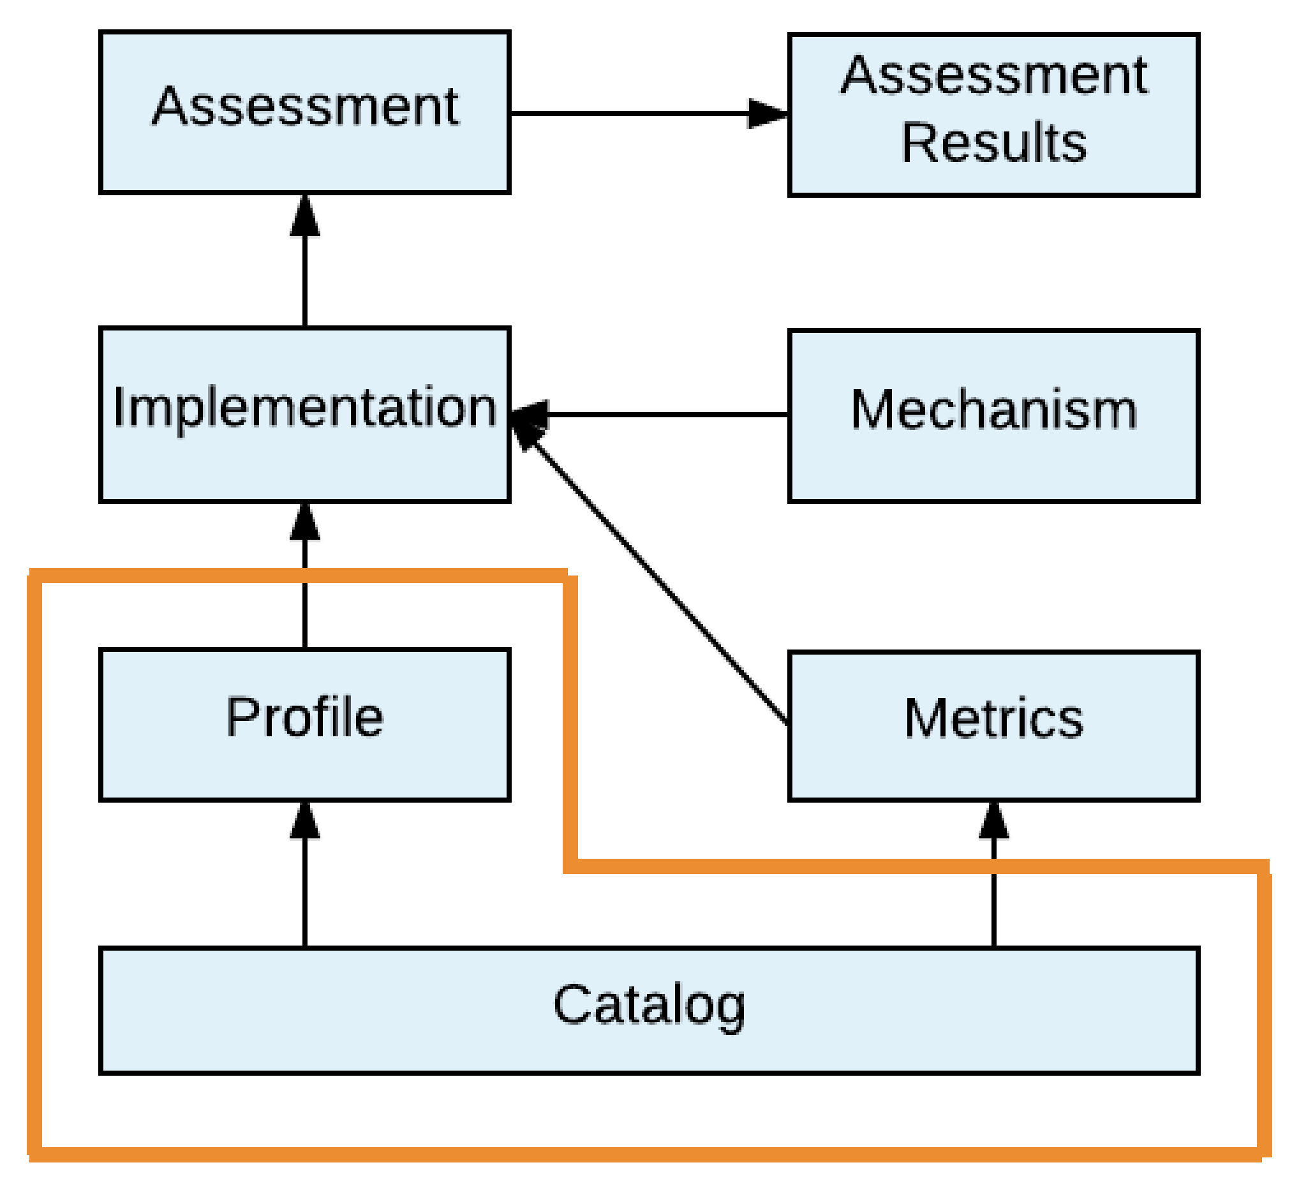
Current focus

Slide 7
Descriptions of current components
Catalog: Defines a set of security controls (e.g., NIST SP 800-53 Appendix F); may also define objectives and methods for assessing the controls (e.g., NIST SP 800-53A)
Profile: Defines a set of security requirements, where meeting each requirement necessitates implementing one or more security controls

Slide 8
Initial project scope
Represent catalogs in a standardized, machine-readable format.
Normalize semantics across catalogs.
Represent profiles in standardized, machine-readable formats that map profile requirements to the corresponding controls within catalogs.
Identify which controls from one or more catalogs are required by a particular profile.
Enable a profile user to customize it for controls with options, such as specifying the timeout for idle sessions.

Slide 9
OSCAL users within the current scope
Producers
Catalog maintainers: publishing catalogs into OSCAL format (e.g., NIST, ISO, ISACA)
Standard profile maintainers: profiles in OSCAL format used by many organizations consuming OSCAL catalogs (e.g., NIST, FedRAMP)
Custom profile maintainers: developing new profiles or customizing existing profiles for organization-specific use (e.g., cloud service providers, integrators)
Tool vendors: creating tools that use OSCAL to support risk assessment, continuous monitoring, compliance reporting, and other purposes
Consumers
Operations personnel
Security and privacy personnel
Auditors/assessors
Policy personnel
Others

Slide 10
Benefits for OSCAL consumers
Operations personnel: rapidly verify that systems comply with organizational security requirements
Security and privacy personnel: automatically identify problems and address them quickly before loss or damage occur
Auditors/assessors: perform audits/assessments on demand with minimal effort
Policy personnel: identify systemic problems that necessitate changes to organization security policy

Slide 11
OSCAL project approach
Using an agile approach
Having monthly sprints with one or more user stories per sprint
Developing OSCAL iteratively instead of trying to engineer the entire solution at once
Implementing the 20% of the functionality that solves 80% of the problem
Moving from a manual mapping approach to an automatic one

Slide 12
OSCAL deliverables
XML Schemas | Validate catalogs and profiles against constraints
XSL Templates | Produce human-readable versions (PDFs)
CSS | Edit OSCAL catalogs and profiles using XML tools
Prose Documentation | Define the OSCAL specification Explain how organizations can convert existing catalogs and profiles into OSCAL formats
Will be posted to GitHub

Slide 13
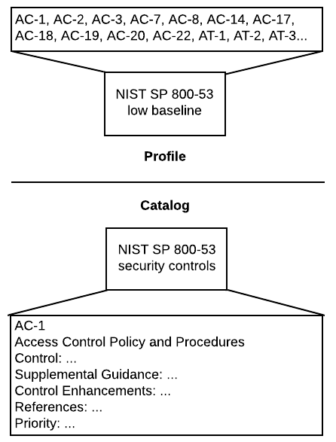
Profile and catalog mapping: a trivial example
Representing an NIST SP 800-53 low baseline:
NIST SP 800-53 catalog defines possible security controls within its scope
NIST SP 800-53 profile indicates which security controls from the catalog are required to be compliant
Clear mapping between the controls specified in the profile and the controls defined in the catalog
OSCAL provides a standardized, machine-readable profile with clear semantics
Other catalogs and profiles can use the same interoperable format (e.g., ISO/IEC 27001/2)

Slide 14
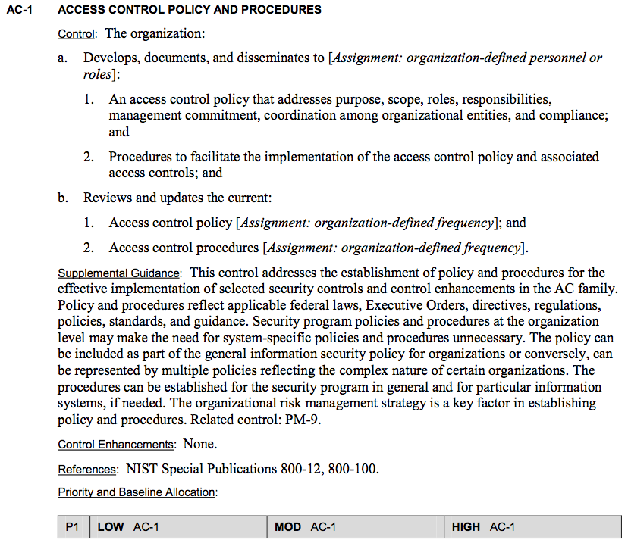
Prose vs. OSCAL (Machine-Readable)
<catalog xmlns="http://scap.nist.gov/schema/oscal"> <title>NIST SP800-53</title> <declarations href="800-53-declarations.xml"/> <group class="family"> <title>ACCESS CONTROL</title> <control class="SP800-53"> <title>ACCESS CONTROL POLICY AND PROCEDURES</title> <prop class="number">AC-1</prop> <prop class="priority">P1</prop> <feat class="statement"> <prop class="description">The organization:</prop> <feat class="statement"> <prop class="number">AC-1a.</prop> <prop class="description">Develops, documents, and disseminates to [Assignment: organization-defined personnel or roles]:</prop> <feat class="statement-item"> <prop class="number">AC-1a.1.</prop> <prop class="description">An access control policy that addresses purpose, scope, roles, responsibilities, management commitment, coordination among organizational …[snip]…</prop> </feat> </feat> </feat>
…[snip]… <references> <ref> <citation href="http://csrc.nist.gov/publications/PubsSPs.html#800-12">NIST Special Publication 800-12</citation> </ref> …[snip]… </references> </control>
</group>
</catalog>

Slide 15
Prose vs. OSCAL (Machine-Readable)
Control Title
<catalog xmlns="http://scap.nist.gov/schema/oscal"> <title>NIST SP800-53</title> <declarations href="800-53-declarations.xml"/> <group class="family"> <title>ACCESS CONTROL</title> <control class="SP800-53"> <title>ACCESS CONTROL POLICY AND PROCEDURES</title> <prop class="number">AC-1</prop> <prop class="priority">P1</prop> <feat class="statement"> <prop class="description">The organization:</prop> <feat class="statement"> <prop class="number">AC-1a.</prop> <prop class="description">Develops, documents, and disseminates to <assign id=“ac1a">
organization-defined personnel or roles</assign></prop> <feat class="statement-item"> <prop class="number">AC-1a.1.</prop> <prop class="description">An access control policy that addresses purpose, scope, roles, responsibilities, management commitment, coordination among organizational …[snip]…</prop> </feat> </feat> </feat>
…[snip]… <references> <ref> <citation href="http://csrc.nist.gov/publications/PubsSPs.html#800-12">NIST Special Publication 800-12</citation> </ref> …[snip]… </references> </control>
</group>
</catalog>

Slide 16
Prose vs. OSCAL (Machine-Readable)
<catalog xmlns="http://scap.nist.gov/schema/oscal"> <title>NIST SP800-53</title> <declarations href="800-53-declarations.xml"/> <group class="family"> <title>ACCESS CONTROL</title> <control class="SP800-53"> <title>ACCESS CONTROL POLICY AND PROCEDURES</title> <prop class="number">AC-1</prop> <prop class="priority">P1</prop> <feat class="statement"> <prop class="description">The organization:</prop> <feat class="statement"> <prop class="number">AC-1a.</prop> <prop class="description">Develops, documents, and disseminates to <assign id=“ac1a">
organization-defined personnel or roles</assign></prop> <feat class="statement-item"> <prop class="number">AC-1a.1.</prop> <prop class="description">An access control policy that addresses purpose, scope, roles, responsibilities, management commitment, coordination among organizational …[snip]…</prop> </feat> </feat> </feat>
…[snip]… <references> <ref> <citation href="http://csrc.nist.gov/publications/PubsSPs.html#800-12">NIST Special Publication 800-12</citation> </ref> …[snip]… </references> </control>
</group>
</catalog>
Control Text

Slide 17
Prose vs. OSCAL (Machine-Readable)
<catalog xmlns="http://scap.nist.gov/schema/oscal"> <title>NIST SP800-53</title> <declarations href="800-53-declarations.xml"/> <group class="family"> <title>ACCESS CONTROL</title> <control class="SP800-53"> <title>ACCESS CONTROL POLICY AND PROCEDURES</title> <prop class="number">AC-1</prop> <prop class="priority">P1</prop> <feat class="statement"> <prop class="description">The organization:</prop> <feat class="statement"> <prop class="number">AC-1a.</prop> <prop class="description">Develops, documents, and disseminates to <assign id=“ac1a">
organization-defined personnel or roles</assign></prop> <feat class="statement-item"> <prop class="number">AC-1a.1.</prop> <prop class="description">An access control policy that addresses purpose, scope, roles, responsibilities, management commitment, coordination among organizational …[snip]…</prop> </feat> </feat> </feat>
…[snip]… <references> <ref> <citation href="http://csrc.nist.gov/publications/PubsSPs.html#800-12">NIST Special Publication 800-12</citation> </ref> …[snip]… </references> </control>
</group>
</catalog>
Parameter Assignment

Slide 18
Prose vs. OSCAL (Machine-Readable)
<catalog xmlns="http://scap.nist.gov/schema/oscal"> <title>NIST SP800-53</title> <declarations href="800-53-declarations.xml"/> <group class="family"> <title>ACCESS CONTROL</title> <control class="SP800-53"> <title>ACCESS CONTROL POLICY AND PROCEDURES</title> <prop class="number">AC-1</prop> <prop class="priority">P1</prop> <feat class="statement"> <prop class="description">The organization:</prop> <feat class="statement"> <prop class="number">AC-1a.</prop> <prop class="description">Develops, documents, and disseminates to <assign id=“ac1a">
organization-defined personnel or roles</assign></prop> <feat class="statement-item"> <prop class="number">AC-1a.1.</prop> <prop class="description">An access control policy that addresses purpose, scope, roles, responsibilities, management commitment, coordination among organizational …[snip]…</prop> </feat> </feat> </feat>
…[snip]… <references> <ref> <citation href="http://csrc.nist.gov/publications/PubsSPs.html#800-12">NIST Special Publication 800-12</citation> </ref> …[snip]… </references> </control>
</group>
</catalog>
Document Reference

Slide 19
Completed sprints
Sprint 1 (June 2017)
Redesigned the OSCAL model from scratch.
Represented control information from NIST SP 800-53 and ISO 27002 in a common format.
Sprint 2 (July 2017)
Represented control information from NIST SP 800-53, ISO 27002, and a subset of COBIT 5 in a common format.
Displayed all NIST SP 800-53 control catalog entries that corresponded to each NIST SP 800-53 baseline (low, moderate, high).
Decided to merge NIST SP 800-53A into the catalog model.

Slide 20
Current sprint (Sprint 3, August 2017)
Document the OSCAL artifacts on GitHub and how they can be used.
Create a profile that references controls from multiple OSCAL catalogs.
Represent single-valued parameter options for NIST SP 800-53 controls.
Set single-valued parameters for a NIST SP 800-53 baseline’s controls.
Document OSCAL’s purpose, benefits, uses, components, and high-level architecture in Word and Powerpoint formats.
Document the catalog schema’s composition within the XML schema and in Word and Powerpoint formats.

Slide 21
Notional plan for Sprint 4 (Sept. 2017)
Stabilize the catalog and profile models
Ensure the GitHub files are adequately documented
Complete an initial discussion draft for the OSCAL specification

Slide 22
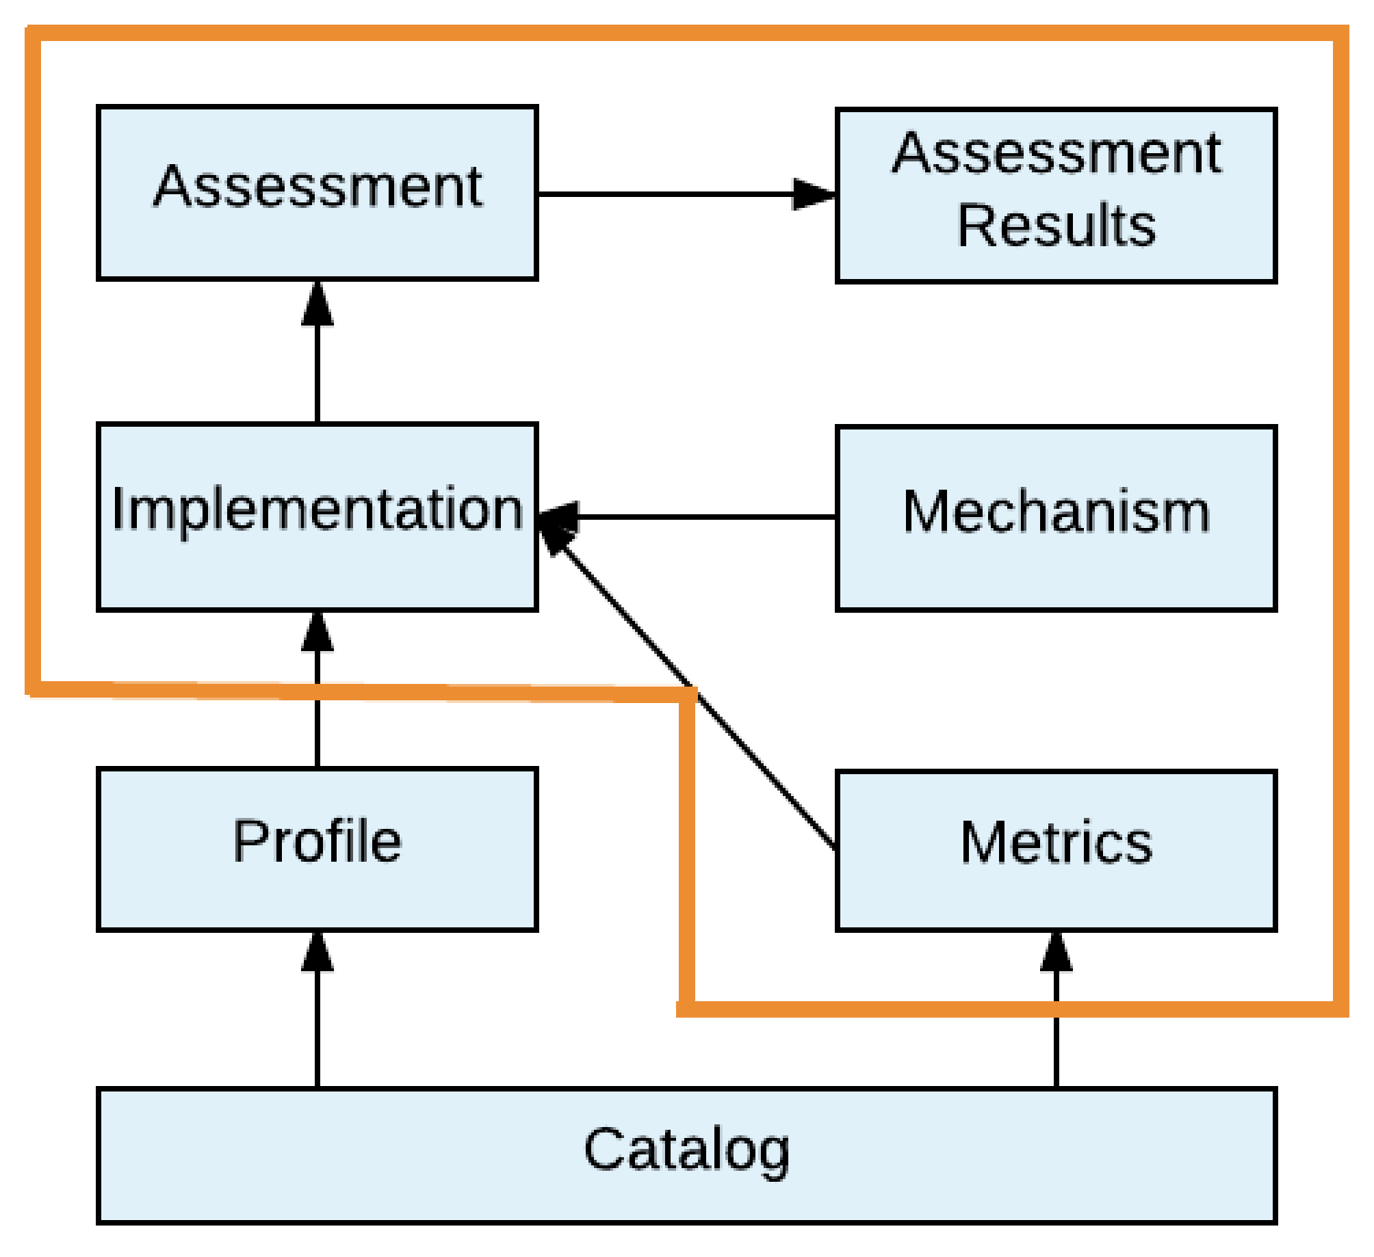
Future focus

Slide 23
Descriptions of future components
Implementation: Defines how each profile item is implemented (System Security Plan)
Assessment: Describes how the system assessment is to be performed
Assessment Results: Records the findings of the assessment
Metrics: Defines metrics and measurements for understanding the effectiveness of the system’s security
Mechanism: Describes methods used to monitor the system’s current security state (e.g., Security Content Automation Protocol (SCAP))

Slide 24
Future OSCAL work
Represent the following in standardized, machine-readable formats:
How each control is implemented on a system
Which controls are applicable to a system
How each control on a system can be assessed (procedures) to ensure it’s implemented and operating properly
How the control implementations on a system can be measured (metrics)
Identify which controls from a profile are implemented on a system.
Verify whether each control meets the options (parameters) specified in the profile.

Slide 25
Long-term goals
Have OSCAL-enabled tools and OSCAL-formatted content widely available
Have OSCAL use enable:
A large decrease in assessment-related labor
The ability to assess a system’s security much more often, ideally continuously
The ability to assess a system’s compliance with several sets of requirements simultaneously
The consistent performance of assessments, regardless of system type

Slide 26
For more information
Email the OSCAL team at oscal@nist.gov
Michaela Iorga, NIST
Anil Karmel, C2 Labs
Wendell Piez, C2 Labs
Karen Scarfone, C2 Labs
David Waltermire, NIST

